Slide 1


Restorative Justice & Radicalisation: From theory to practice
2nd Biennial International conference on Restorative Justice, Tehran, Iran (4-5 May 2018)
Dr. Theo Gavrielides
Founder & Director
IARS International Institute
RJ4All Institute
YEIP

Slide 2

What is this session about?
Perceptions & Realities of security: The new reality
The new face of terror & terrorism
Restorative justice and empathy: From theory to practice
Restorative justice and positive thinking
Restorative justice & Islam

Slide 3
What are my goals?
Inform – the educative part
Challenge – the dodgy part
Learn – the debating part

Slide 4
My Claim
The road that we have taken for security policy and practice internationally is leading to further division and the erosion of our societal values.
This is by no coincidence

Slide 5
My argument
We are in a democratic deficit perpetuated by a number of challenges such as the economic downturn, fears of security, nationalism and the continuous marginalisation of the disempowered.
To maintain this deficit, control is exercised through fear:
Security terror (terrorism & radicalisation)
Financial terror (financial crisis)
Identity terror (nationalism)

Slide 6
My assumption
There is an alternative vision for social cohesion
As we explore new avenues, I ask:
What is the role of restorative justice?
What are the limitation of restorative justice?
What is the role of society?
What is my role?
What is yours?

Slide 8
How secure is our world today?

Slide 9
The new reality

Slide 10
Lets take a step back – how did we get here in the first place?
The ideologies that provide inspiration for extremist groups:
religious inspired extremism
left wing
anarchist
right wing
nationalist and separatist ideologies

Slide 11
The new face of terror since September 11
Terrorists are no longer seen to be acting alone. Terrorist powerful networks do exist.
The use of weapons of mass destruction is possible including nuclear and biological weapons
Terrorism as an act cannot be confined by time, place or nation.

Slide 12
A role for restorative justice? Really?
Sometimes, one must accept that priority for public security can overrule the pursuit of a restorative response.
Is this where even Nils Christie (1981) accepted ‘absolute
punishment’ to express the massive grief and mourning after terrible crimes?

Slide 13
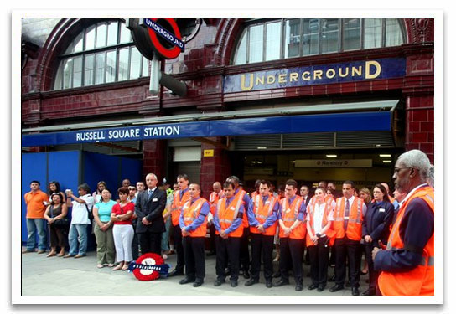
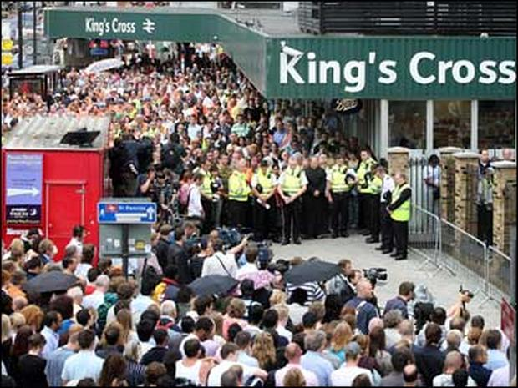
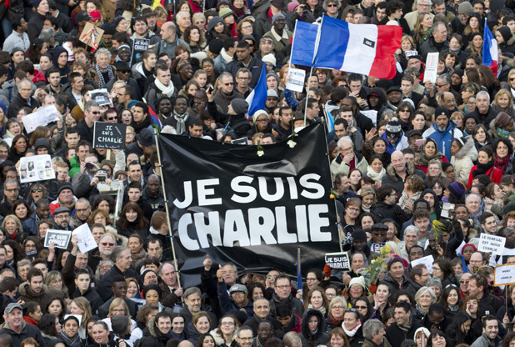
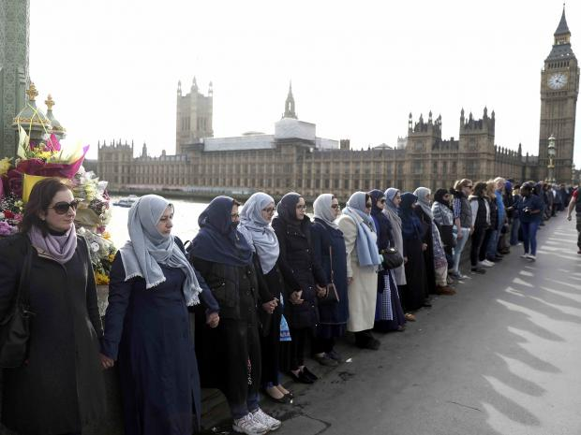
The actual reality - kindness

Slide 14

The actual reality - kindness
Over 1,000 phone calls were made within ten minutes of the first plane hitting Twin Towers. Some of the people who lost their lives that day were able to send one last message to the outside world. From flight attendants to World Trade Centre employees, firemen to the terrorists themselves:
“You gotta think positive, because you gotta help each other get off the floor”
“Hi baby. You have to listen to me carefully. I’m on a plane that’s been hijacked … I want to tell you that I love you. Please tell my children that I love them very much”
“There’s three guys, they’ve hijacked the plane… we’re turned around and I heard that there’s planes that have been flown into the World Trade Centre. I hope to see your face again, baby. I love you. Bye.”

Slide 15
Yes, really!
… but before we make such a claim, I must ask:
Who is the “victim”?
Who is the “offender”?
What are we restoring?

Slide 16
The five victims of terror
Primary victims: those who have been victimised physically
Collateral victims: those who have witnessed the attack and are not physically wounded, but still might suffer from traumatic consequences
Secondary victims: family members (relatives) and those who are very close (intimate friends, close colleagues, etc.) to the primary victims
Tertiary/ vicarious victims: those who feel affected and concerned by what happened (the ‘public’)
The forgotten victims: the relatives of the offenders and their community. They are terrified by what their son/brother/ neighbour has done and they fear undergoing ‘collateral’ stigmatisation.

Slide 17
The target
The essential victim (target) is the vicarious victim i.e. the public
Attack = terrifying message -> to the public -> to disturb social life
Making physical/ primary victims is just the tool/ message generators
Achieving such high impact on the whole community is possible only through the help of the media, the message transmitters
Without modern media, terrorism in its modern form would probably not exist.

Slide 18
The why
The micro-level (the ‘vulnerability’ of the individual)
The meso-level (the supportive or even complicit social surround)
The macro-level (the radicalisation of a part of the relevant public opinion).
To answer this combination of factors and dynamics, restorative justice in the strict sense is not sufficient.

Slide 19
The vulnerability of the individual
Vulnerability is defined as the quality or state of being exposed to the possibility of being attacked or harmed, either physically or emotionally
The conditions that have the greatest influence on vulnerability have a relational basis
How we deal with vulnerability determines the nature of our relationships. Research suggests that those who experience vulnerability but feel they are worthy of loving and belonging have strong relationships.

Slide 20
The vulnerability of the individual
“Where individual wrong doers are confronted within a continuum of respect and support, then a process of reintegration can begin’. John Braithwaite
"If the hijackers had been able to imagine themselves into the thoughts and feeling of the passengers, they would have been unable to proceed. It is hard to be cruel once you permit yourself to enter the mind of your victim. Imagining what it is like to be someone other than yourself, is at the core of our humanity. It is the essence of compassion, and it is the beginning of morality”.
Ian McEwan

Slide 21
Empathy & the possibilities
“Where individual wrong doers are confronted within a continuum of respect and support, then a process of reintegration can begin’. John Braithwaite
"If the hijackers had been able to imagine themselves into the thoughts and feeling of the passengers, they would have been unable to proceed. It is hard to be cruel once you permit yourself to enter the mind of your victim. Imagining what it is like to be someone other than yourself, is at the core of our humanity. It is the essence of compassion, and it is the beginning of morality”.
Ian McEwan

Slide 22
Empathy & the possibilities
Em (in) – pathy (πάθος) = πόνος = pain (sharing the pain)
Sym (with) – pathy (πάθος) = συμπωνώ (observing/ acknowleding the pain)

Slide 23
Empathy & the possibilities
Terrorists meeting the children or family members of their victims many years later:
Colombia (Bueno, 2013 )
Spanish-Basque conflict (Rodriguez, 2013 ).
The Israel-Palestinian conflict and in other examples described in Staiger [2010]

Slide 24
The “assumptions” (theory)
The pre-existence of a “social liaison” (Gavrielides, 2005; 2016)
We derive our identity from being with others
Dialogue that focuses on ‘harm’ rather than ‘blame’ is likely to strengthen relationships and reduce vulnerability
Stronger relationships are likely to deter violent extremism.

Slide 25
The reality
The institutional context/ the criminal justice system
The political context – the rhetoric of safety
The societal context – an eye for an eye
The financial context – value for money

Slide 26
The role and the limitation of restorative justice
The educative role of restorative justice
Its contribution to strengthening the fabric of our societies
Reforming the real terrorist within

Slide 27
It is already happening!

Slide 28
Where do we go from here?
The law alone cannot bring social justice!
It is through the result of millions of small actions that we change status quo.
The role of civil society has long been underestimated and it is now becoming clearer that without the NGOs, movements and campaigns that comprise it, governments and other vessels of power would not be held to account.
Disadvantage thinking vs positive thinking

Slide 29
The foundations of positive thinking
People are not “risks” to manage
People “at risk” have talents and it is those that we need to target for nurturing – not the “offender”! (Good Lives Model)
Europe needs the hopes and ideals of young people more than ever. This cannot be a mere statement of intent and theory, but one of genuine and proactive action.

Slide 30
.. But first, we need to put the restorative justice house in order
Global hysteria
Value for money
Policy without evidence
Institutionalisation and legalisation
Top down structures and control
Professionalisation, registration and accreditation
Moral justification?
The battles within….
Inclusion without inclusion

Slide 31
Restorative Justice, Islam and being inclusive
Restorative Justice and Islam:
“if two faction among the believers should fight, then make settlement [suluh] between the two”
Qur'an at 49:9 reads:

Slide 32
Restorative justice and Islam
The law of qisas
the practices of conciliation (suluh) by service for the benefit of the victim
compensation (diyya)
isolation (hajr)
pardon (afou)
community service (akila and diwan)
warning (hisba)
expiation (kafara)
surety (kafala)
Intercession (shafaa)
repentance (tawba)
preserving privacy (satr)

Slide 33
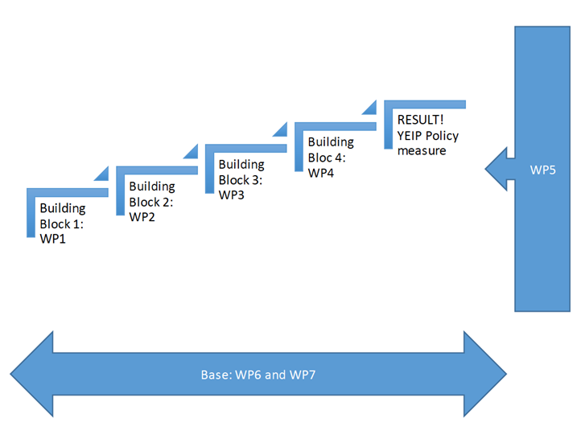
A case study: The Youth Empowerment & Innovation Project (Erasmus KA3)
YEIP’s aim is to construct a policy measure that will help enhance social cohesion and prevent violent radicalisation of young people in Europe. To this end, it will construct evidenced-based tools (YEIP PREVENT model, toolkit, training programme) that will allow the delivery of direct interventions in 4 different environments that will be evaluated prior to rolling out the policy measure. To ensure that our results are translated into policy making at a national level, we put together a partnership of 8 EU member states consisting of:
1 Public Authority per country that would be able to take strategic leadership in the Call’s area of PT7
1 Researcher per country that would carry out in an independent and robust manner the action research/ field trials, while acting as the main point of contact between the Coordinator and the given Public Authority
2 examples of Target Groups with practical expertise to ensure user engagement.

Slide 34
Thank You!
The IARS International Institute
14 Dock Offices
Surrey Quays Road
London SE16 2XU
United Kingdom
www.iars.org.uk
contact@iars.org.uk
Tel. (0044) 207 064 4380

